Slide 1
26th June 2012 Alcohols
AIM – to describe the reactions of alcohols

Slide 2
Alcohols are compounds in which one or more hydrogen atoms in an alkane have been replaced by an -OH group.

Slide 3
Alcohols fall into different classes depending on how the -OH group is positioned on the chain of carbon atoms
There are chemical differences between the various types.

Slide 4
Primary alcohols
In a primary (1°) alcohol, the carbon which carries the -OH group is only attached to one other carbon atom.

Slide 5
Secondary alcohols
In a secondary (2°) alcohol, the carbon with the -OH group attached is joined directly to two other carbon atoms

Slide 6
Tertiary alcohols
In a tertiary (3°) alcohol, the carbon atom holding the -OH group is attached directly to three alkyl groups

Slide 7
Manufacturing alcohols
Most alcohols such as ethanol are manufactured by reacting alkenes with steam
They can also be made by substitution of a haloalkane

Slide 8
Ethanol can also be produced by fermentation

Slide 9
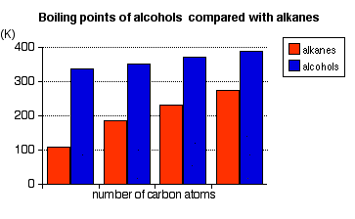
Physical properties
The melting and boiling point of an alcohol is always much higher than that of the alkane with the same number of carbon atoms.
The melting and boiling points of alcohols increases as the number of carbon atoms increases.

Slide 10
Chemical properties
Alcohols combust readily
Alcohols can be oxidised
Alcohols can be dehydrated – an elimination reaction
Alcohols can undergo substitution reactions

