Slide 1
21st June 2012 Polymerisation
AIM – to explain how the properties of alkenes allow polymerisation

Slide 2
Key words
monomer – one unit in a chain
polymer – many units joined together

Slide 3
Poly(ethene) (polythene or polyethylene)
This is an example of addition polymerisation.
During the polymerisation of ethene, thousands of ethene molecules join together to make poly(ethene) - commonly called polythene.

Slide 4
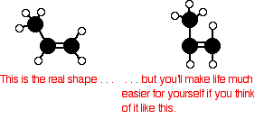
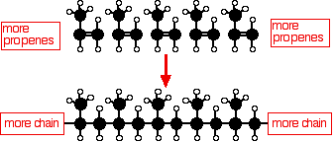
Poly(propene) (polypropylene): PP

Slide 5
In an equation form, this is normally written as:

Slide 6
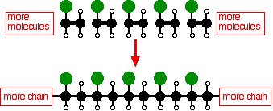
Poly(chloroethene) (polyvinyl chloride): PVC
Poly(chloroethene) is made by polymerising chloroethene, CH₂=CHCl.

Slide 7
The equation is usually written
It doesn't matter which carbon you attach the chlorine to in the original molecule. Just be consistent on both sides of the equation.

Slide 8
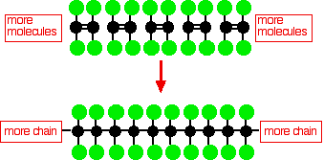
Poly(tetrafluoroethene): PTFE
You may have come across this under the brand names of Teflon or Fluon.
PTFE is just like poly(ethene) except that each hydrogen in the structure is replaced by a fluorine atom.

