Slide 1
15th June 2012 Alkenes
AIM – to investigate the physical and chemical properties of alkenes

Slide 2
Alkenes are a family of hydrocarbons containing a carbon-carbon double bond.
The first two are:
You can work out the formula of any of them using: C_{n}H_{2n}
ethene | C₂H₄
propene | C₃H₆

Slide 3
Isomers
All the alkenes with 4 or more carbon atoms in them show structural isomerism.
This means that there are two or more different structural formulae that you can draw for each molecular formula.

Slide 4
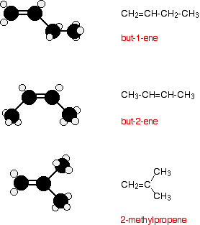
C₄H₈

Slide 5
Use the molecular models to build butane and but-2-ene

Slide 6
Geometric (cis-trans) isomerism
The carbon-carbon double bond doesn't allow any rotation about it. That means that it is possible to have the CH₃ groups on either end of the molecule locked either on one side of the molecule or opposite each other.

Slide 7
These are called cis-but-2-ene (where the groups are on the same side) or trans-but-2-ene (where they are on opposite sides).

Slide 8
Making alkenes
Dehydration of alcohols – an elimination reaction
The acid catalysts normally used are either concentrated sulphuric acid or concentrated phosphoric(V) acid, H₃PO₄.

Slide 9
Physical properties
Boiling Points
The boiling point of each alkene is very similar to that of the alkane with the same number of carbon atoms.
Solubility
Alkenes are virtually insoluble in water, but dissolve in organic solvents.

Slide 10
Chemical properties
Alkenes burn in air or oxygen but the important reactions all centre around the double bond.
Alkenes undergo addition reactions.

Slide 11
Ethene and chlorine or bromine or iodine
In each case you get an addition reaction. For example, bromine adds to give 1,2-dibromoethane.
A liquid alkene (like cyclohexene) can be shaken with liquid bromine a colour change from orange/brown to colourless tells you that a reaction has taken place

Slide 12
Oxidation of alkenes with potassium permanganate
If the potassium permanganate solution is acidified with dilute sulphuric acid, the purple solution becomes colourless.
Permanganate ions are a strong oxidising agent, and oxidise ethene to ethan-1,2-diol

Slide 13
Hydration of alkenes
Alcohols are produced by the direct hydration of alkenes - adding water directly to the carbon-carbon double bond.
An acid catalyst is required

Slide 14
Hydrogenation
Ethene reacts with hydrogen in the presence of a nickel catalyst at a temperature of about 150°C. Ethane is produced.

Slide 15
Some margarine is made by hydrogenating carbon-carbon double bonds in animal or vegetable fats and oils.
You can recognise the presence of this in foods because the ingredients list will include words showing that it contains "hydrogenated vegetable oils" or "hydrogenated fats".

Slide 16
Alkenes and hydrogen halides
All alkenes undergo addition reactions with the hydrogen halides. A hydrogen atom joins to one of the carbon atoms originally in the double bond, and a halogen atom to the other.
For example, with ethene and hydrogen chloride, you get chloroethane:

Slide 17
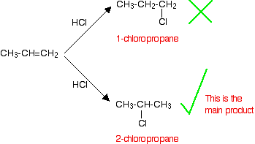
Addition to unsymmetrical alkenes
If HCl adds to an unsymmetrical alkene like propene, there are two possible ways it could add.

Slide 18
This is in line with Markovnikov's Rule
When a compound HX is added to an unsymmetrical alkene, the hydrogen becomes attached to the carbon with the most hydrogens attached to it already.
In this case, the hydrogen becomes attached to the CH₂ group, because the CH₂ group has more hydrogens than the CH group.
Notice that only the hydrogens directly attached to the carbon atoms at either end of the double bond count. The ones in the CH₃ group are totally irrelevant.

