Slide 1
14th June 2012 Alkanes
AIM – to explain the properties of alkanes

Slide 2
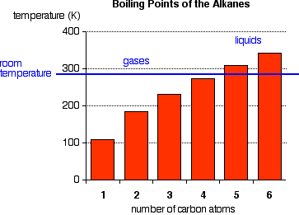
Physical Properties
The first four alkanes are gases at room temperature. Solids don't start to appear until about C₁₇H₃₆.

Slide 3
This is because as molecules get bigger then the forces of attraction between them get bigger.
Bigger forces of attraction mean that the molecules will be held together more firmly i.e. as a solid

Slide 4
Solubility
Alkanes are non-polar molecules so they will not dissolve in a polar solvent like water, but will dissolve in other non-polar organic solvents.

Slide 5
Chemical properties
Complete combustion (given sufficient oxygen) of any hydrocarbon produces carbon dioxide and water.
The hydrocarbons become harder to ignite as the molecules get bigger.

Slide 6
In complete combustion hydrocarbons burn with a blue flame.
Combustion is less complete as the number of carbon atoms in the molecules rises. The bigger the hydrocarbon, the more likely you are to get a yellow, smoky flame.
Incomplete combustion (where there isn't enough oxygen present) can lead to the formation of carbon or carbon monoxide.
C₃H₈ + 3O₂ C + 2CO + 4H₂O

Slide 7
Reactions with the halogens
alkanes and fluorine
This reaction is explosive and you get carbon and hydrogen fluoride produced.
alkanes and iodine
Iodine doesn't react with the alkanes

Slide 8
alkanes and chlorine or bromine
There is no reaction in the dark.
In the presence of a flame, the reactions are like the fluorine one - producing a mixture of carbon and the hydrogen halide.
In the presence of ultra-violet light (sunlight will do). There is a photochemical reaction.

Slide 9
Substitution reactions
hydrogen atoms in the hydrocarbon are replaced (substituted) by chlorine or bromine atoms

