Slide 1
Naming organic compounds
AIM – to be able to name alkanes, alkenes and alkynes

Slide 2
Isomers of C₄H₁₀
We can call this methyl propane as there is only one place for the methyl group to go

Slide 3
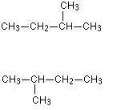
If we have a longer carbon chain then there are more places that the methyl group can go
However if you build these molecules you will see that they are the same – all the single bonds around the carbon atoms can rotate

Slide 4
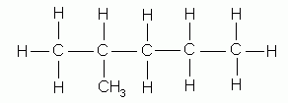
Longer still …..
These compounds are both methylpentane. BUT they are different molecules with different properties because of the different position of the methyl group

Slide 5
Because of this we have to show the position of the methyl group in the chain
To do this we count carbon atoms from the end of the chain nearest to the methyl group
The name of this compound becomes 2-methylpentane
1
2

Slide 6
What is the name of this compound?
3-methylpentane
1
2
3

Slide 7
If there is more than 1 side chain?
2,3-dimethylpentane
A basic rule for organic chemistry names – say what you see!!

