Slide 1
Hydrocarbons
AIM – to investigate the properties of hydrocarbons

Slide 2
Definitions
Hydrocarbons - compounds that contain atoms of carbon and hydrogen only
Saturated – only single bonds between the atoms in a molecule
Unsaturated – the molecule contains carbon/carbon double or triple bonds

Slide 3
Alkanes
Alkanes are the simplest family of hydrocarbons
You can work out the formula of any of them using: C_{n}H_{2n+2}
Write down the names and molecular formula of the first 8 alkanes

Slide 4
Isomers
All the alkanes with 4 or more carbon atoms in them show structural isomerism.
This means that there are two or more different structural formulae that you can draw for each molecular formula.

Slide 5
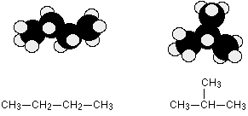
For example, C₄H₁₀ could be either of these two different molecules:
These are called butane and
2-methylpropane.

