Slide 1
16th July 2012 Haloalkanes
AIM – to investigate the properties and reaction of haloalkanes
Haloalkanes are also known as alkyl halides.

Slide 2
Haloalkanes are compounds in which one or more hydrogen atoms in an alkane have been replaced by halogen atoms (fluorine, chlorine, bromine or iodine).
They can be primary, secondary or tertiary following the same rule as for alcohols

Slide 3
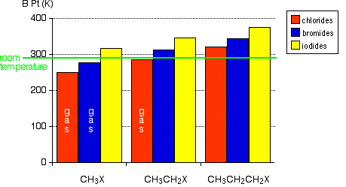
Physical properties of haloalkanes
The chart shows the boiling points of some simple haloalkanes. The patterns in boiling point reflect the patterns in intermolecular attractions

Slide 4
Intermolecular forces get stronger as the molecules get bigger so the boiling points increase.
The increase in boiling point as you go from a chloride to a bromide to an iodide is also because of the increase in mass and size of molecule leading to larger intermolecular forces.

Slide 5
Because carbon-halogen bonds (apart from C – I) are polar, in addition to the dispersion forces there will be forces due to the attractions between the permanent dipoles.
The dipole-dipole attractions fall as the bonds get less polar but the boiling points rise.
This shows that the effect of the permanent dipole-dipole attractions is much less important than that of the temporary dipoles which cause the dispersion forces.

Slide 6
Solubility
The haloalkanes are only very slightly soluble in water.
They are not polar enough to dissolve in a polar solvent

Slide 7
Substitution reactions
These reactions involve either
The carbon-halogen bond breaking to give positive and negative ions and then the ion with the positively charged carbon atom reacts with something fully or slightly negatively charged.
Something either fully or negatively charged attracted to the slightly positive carbon atom and pushing off the halogen atom.
The thing that governs the reactivity is the strength of the bonds which have to be broken. It is difficult to break a carbon-fluorine bond, but easy to break a carbon-iodine one

Slide 8
Substitution with OH⁻
The halogen atom is replaced by an -OH group to give an alcohol.
2-bromopropane is converted into propan-2-ol.
The haloalkane is heated under reflux with a solution of sodium or potassium hydroxide.
The solvent is usually a 50/50 mixture of ethanol and water, because everything will dissolve in that. If you used water alone as the solvent, the haloalkane and the sodium hydroxide solution wouldn't mix.

Slide 9
Elimination with OH⁻
Haloalkanes also undergo elimination reactions in the presence of sodium or potassium hydroxide.
The 2-bromopropane reacts to give propene.
The haloalkane is heated under reflux with a concentrated solution of sodium or potassium hydroxide in ethanol. Propene is formed and, because this is a gas, it passes through the condenser and can be collected.

Slide 10
So which do you get?
The reagents you are using are the same and in each case you will get a mixture of both reactions happening.
What you get most of depends mostly on
The type of haloalkane
primary - mainly substitution
secondary - both substitution and elimination
tertiary - mainly elimination

